Slide 1
Norton’s Theorem
AC Circuit Annalysis
Presenter:
Supervisor:
Mehrin Farzana
ID. 2101013
IoT, Dept. of ICT
BDU
2021-22
Sadiya Enam
Lecturer(EEE)
Dept. of ICT
BDU

Slide 2
contents
01
Statement of Norton’s Theorem
Relation between Thevenin Equivalent Circuit & Norton Equivaletn Circuit
02
03
Algorithm with example

Slide 3
01
STATEMENT OF NORTON’S EQUIVALENT CIRCUIT
NORTON’S THEOREM
Any linear two terminal network can be reduced to a simple current source, I_{N}, in parallel with an internal impedance Z_{N}.
I_{N} is the short circuit current through the terminals
Z_{N} is the is the input or equivalent impedence at the terminals when the independent sources are turned off.

Slide 4
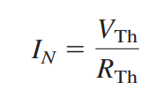


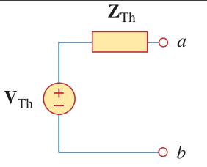
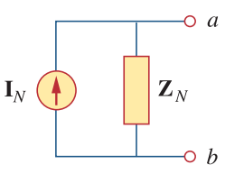
02
Relation between Thevenin Equivalent Circuit & Norton Equivaletn Circuit
HOW THEY RELATE
SOURCE TRANSFORMATION
If a Thévenin equivalent is found, a source conversion can be performed on it to yield the Norton equivalent.

Slide 5
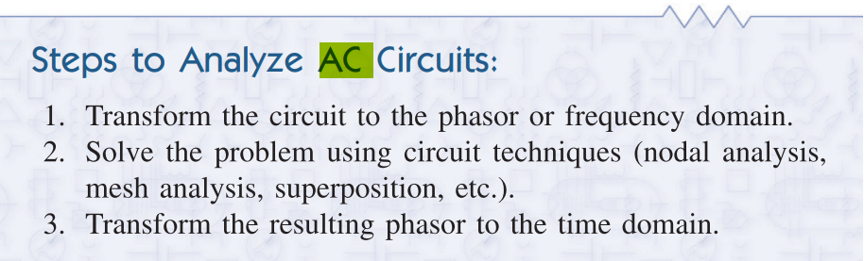
03
Algorithm with example
AC CIRCUIT ANALYSIS

Slide 6
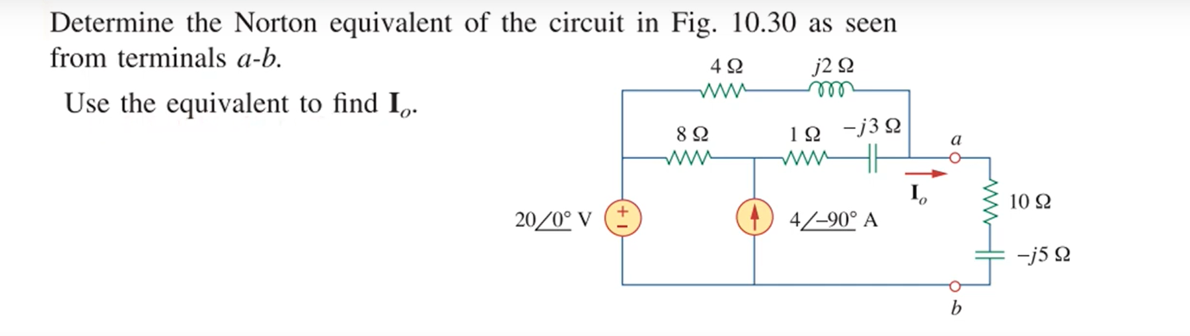

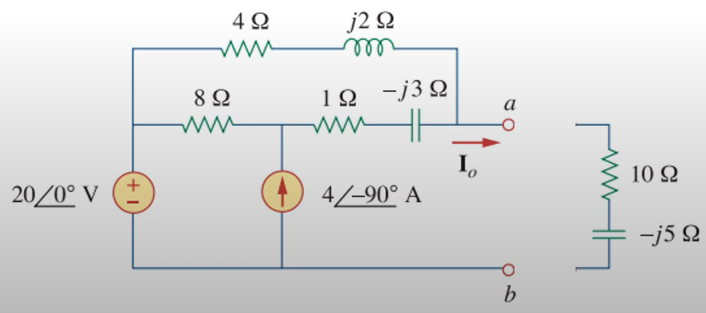
03
Algorithm for transforming circuits
EXAMPLE
STEP 01

Slide 7
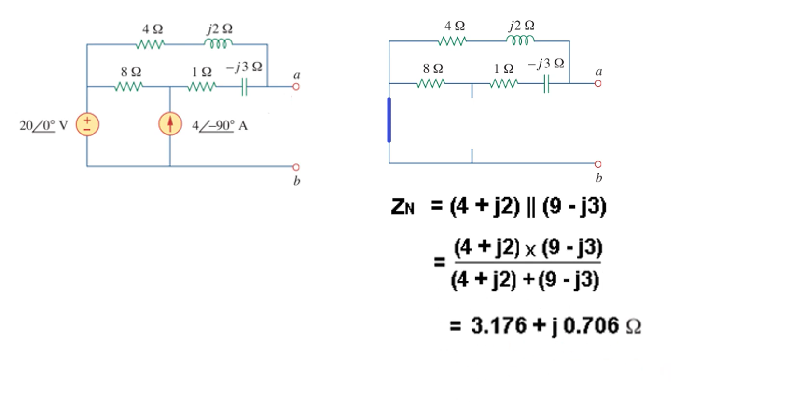
03
Algorithm for transforming circuits
TO OBTAIN Z_{N}

Slide 8
If the given circuit
had a dependant
voltage source

Slide 9




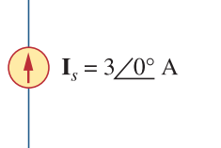

03
Algorithm for transforming circuits
If the given circuit had a dependant voltage source
+
V_{S}
₋₋₋₋₋₋₋₋₋
I_{S}
I₀
I₀
Z_{N} =
-
V_{S} = ( 8 + 1 - j3 ) * I₀
= 54 + j18
KCL,
I₀ - 0.5I₀ - I_{S} = 0 -------------------(i)
Z_{N} = V_{S} / I_{S}
= 18 + j3
I_{S} = 3 --------------------------------(ii)
.’. I₀ = 6 A

Slide 10
And now
Back to the original question

Slide 11
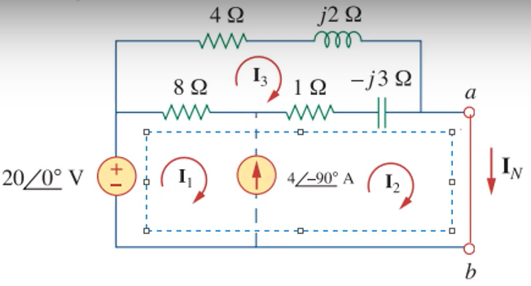
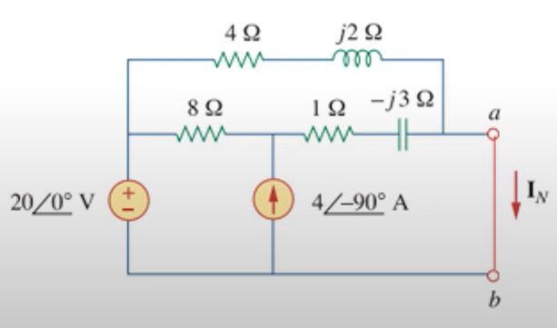
03
TO OBTAIN I_{N}
Algorithm for transforming circuits

Slide 12
03
TO OBTAIN I_{N}
Algorithm for transforming circuits
c

Slide 13
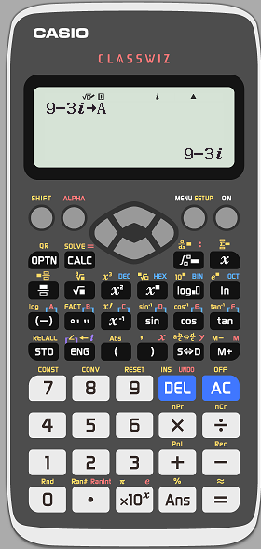
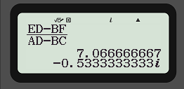
03
TO OBTAIN I_{N}
Algorithm for transforming circuits
I₂ substituted,
CALCULATOR HACK
A
B
I₁
E
=
C
D
I₃
F
Solving by matrix, Cremar’s method;
ED - BF
I₁ =
AD - BC
9-j3
-9+j3
I₁
32+j4
=
-9+j3
13-j
I₃
-12-j4

Slide 14
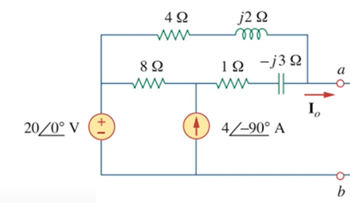
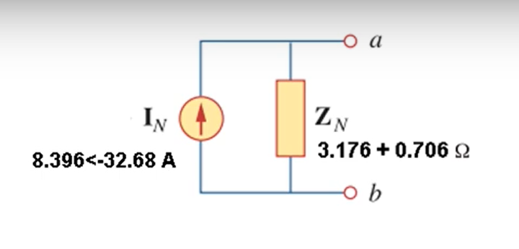
03
SOLVED
Algorithm for transforming circuits
I_{N} = I₂ = I₁ - j4
= 7.0667 - j4.533
= 8.396<-32.678º
Original circuit
Norton equivalent circuit

Slide 15

THANK YOU!
Source: Electrical Engineering Academy

